Slide 1
Chapter 5 Control Statements: Part 2; Logical Operators
Java How to Program, 11/e
Questions? E-mail paul.deitel@deitel.com

Slide 2
5.1 Introduction
for iteration statement
do…while iteration statement
switch multiple-selection statement
break statement
continue statement
Logical operators
Control statements summary.

Slide 3
5.2 Essentials of Counter-Controlled Iteration
Counter-controlled iteration requires
a control variable (or loop counter)
the initial value of the control variable
the increment by which the control variable is modified each time through the loop (also known as each iteration of the loop)
the loop-continuation condition that determines if looping should continue.

Slide 4
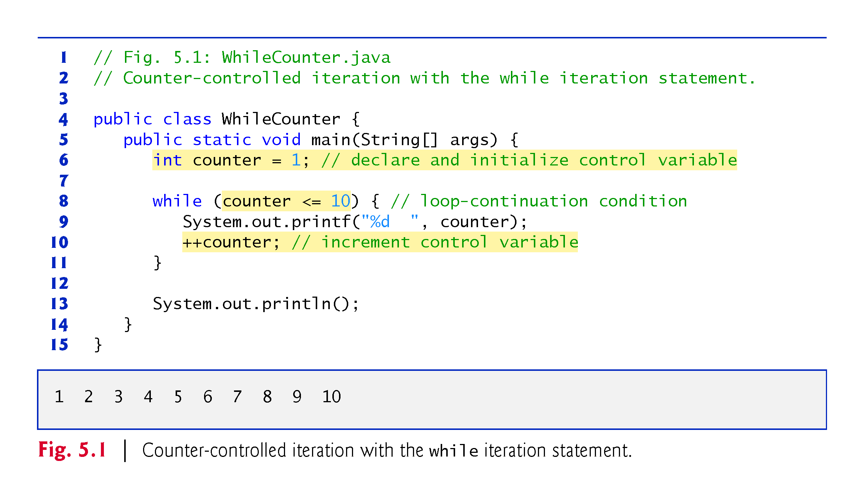

Slide 5
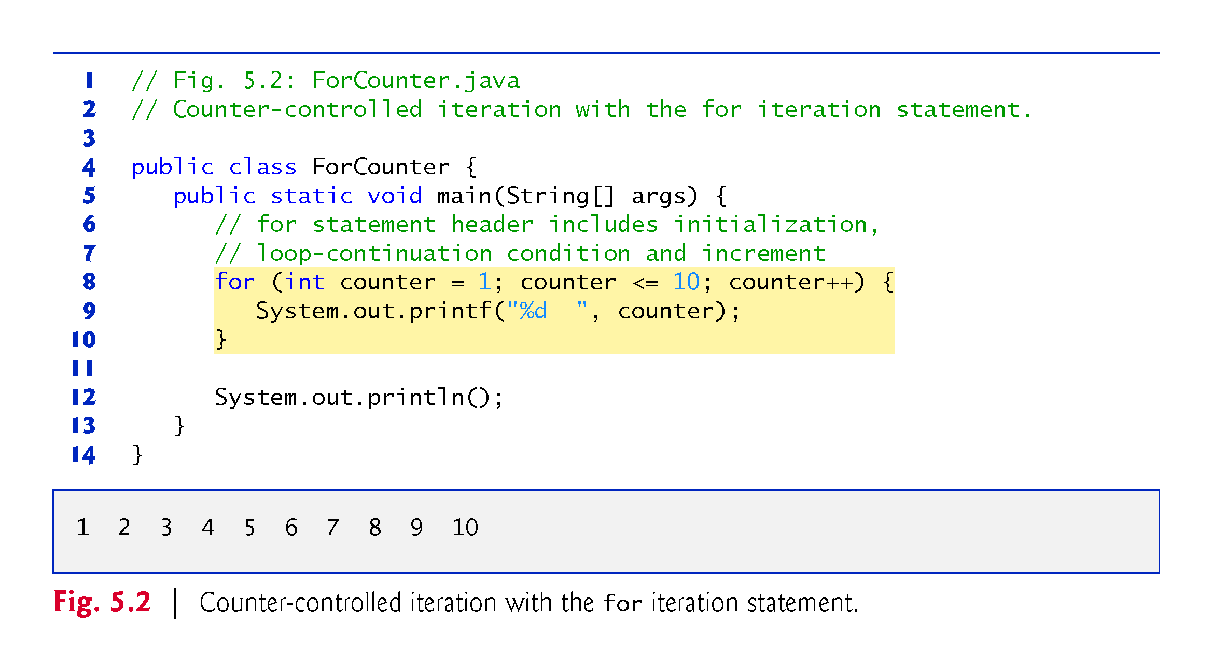

Slide 6
5.3 for Iteration Statement (Cont.)
When the for statement begins executing, the control variable is declared and initialized.
Next, the program checks the loop-continuation condition, which is between the two required semicolons.
If the condition initially is true, the body statement executes.
After executing the loop’s body, the program increments the control variable in the increment expression, which appears to the right of the second semicolon.
Then the loop-continuation test is performed again to determine whether the program should continue with the next iteration of the loop.
A common logic error with counter-controlled iteration is an off-by-one error.

Slide 7
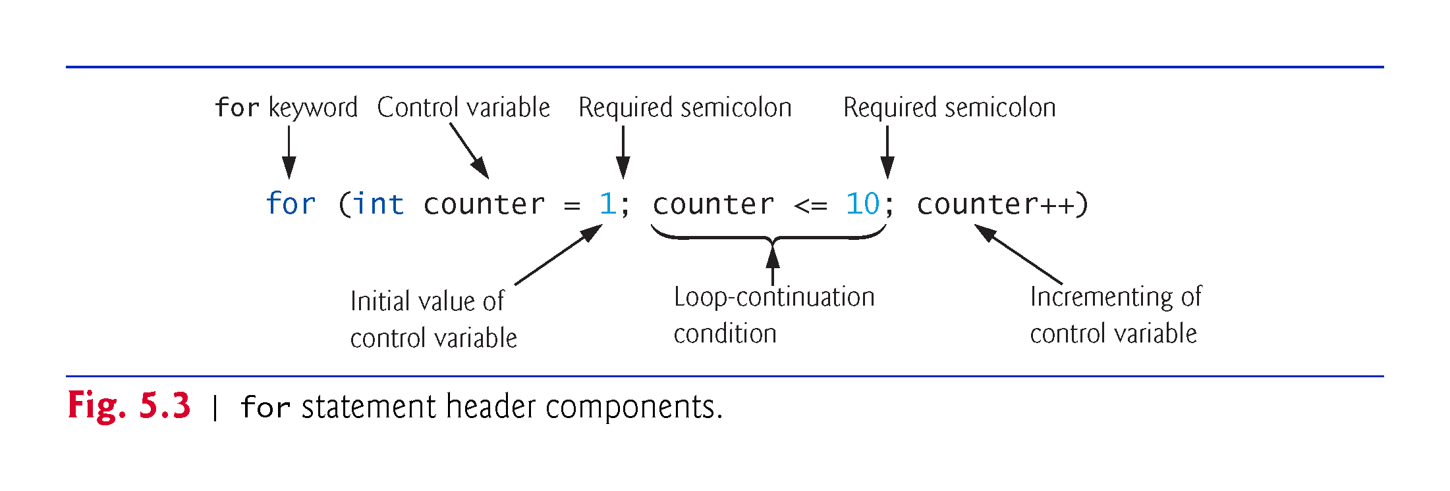

Slide 8
5.3 for Iteration Statement (Cont.)
The general format of the for statement is
for (initialization; loopContinuationCondition; increment) { statement }
the initialization expression names the loop’s control variable and optionally provides its initial value
loopContinuationCondition determines whether the loop should continue executing
increment modifies the control variable’s value, so that the loop-continuation condition eventually becomes false.
The two semicolons in the for header are required.

Slide 9
5.3 for Iteration Statement (Cont.)
The for statement often can be represented with an equivalent while statement as follows:
initialization;
while (loopContinuationCondition) { statement increment; }
Typically, for statements are used for counter-controlled iteration and while statements for sentinel-controlled iteration.
If the initialization expression in the for header declares the control variable, the control variable can be used only in that for statement.

Slide 10
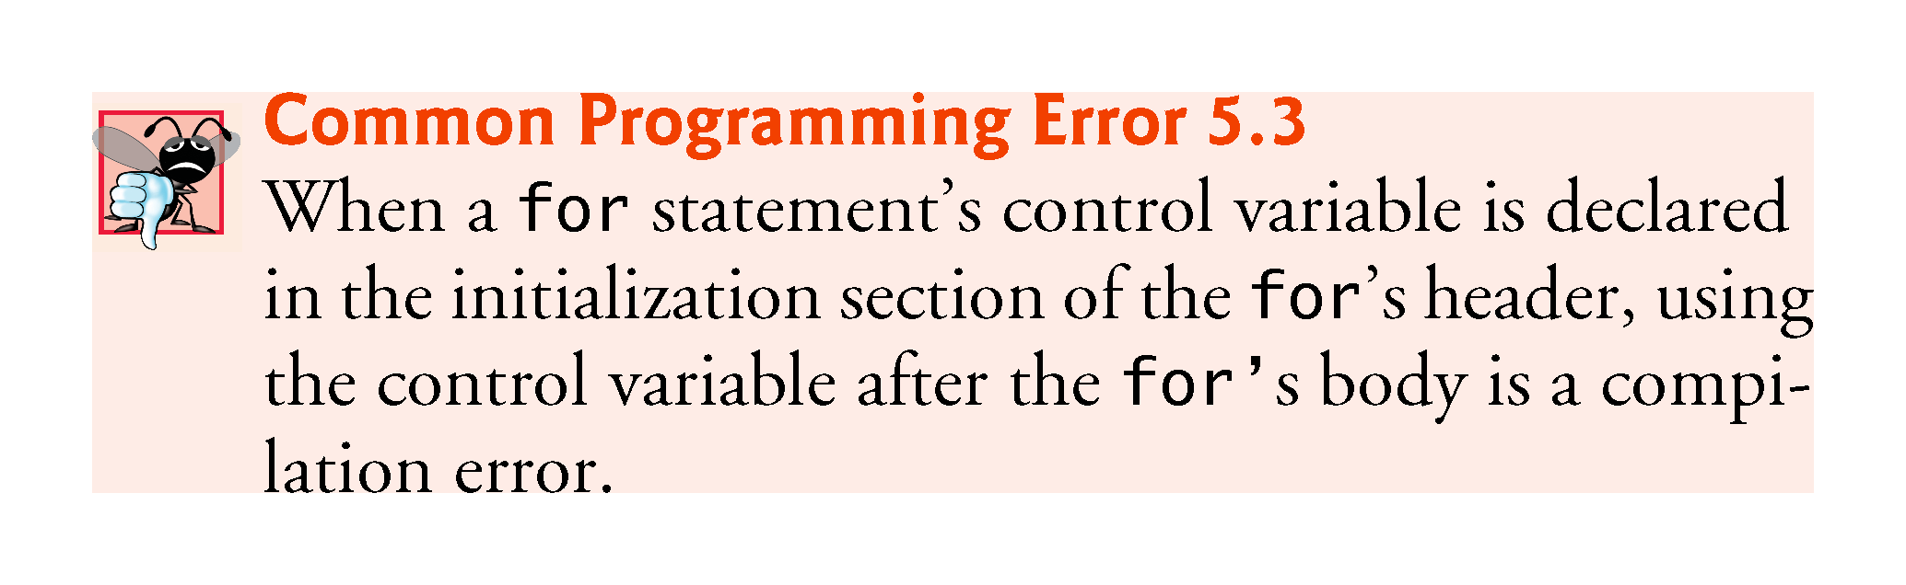

Slide 11
5.4 Examples Using the for Statement
a)Vary the control variable from 1 to 100 in increments of 1.
for (int i = 1; i <= 100; i++)
b)Vary the control variable from 100 to 1 in decrements of 1.
for (int i = 100; i >= 1; i--)
c)Vary the control variable from 7 to 77 in increments of 7.
for (int i = 7; i <= 77; i += 7)

Slide 12
5.4 Examples Using the for Statement (Cont.)
d)Vary the control variable from 20 to 2 in decrements of 2.
for (int i = 20; i >= 2; i -= 2)
e)Vary the control variable over the values 2, 5, 8, 11, 14, 17, 20.
for (int i = 2; i <= 20; i += 3)
f)Vary the control variable over the values 99, 88, 77, 66, 55, 44, 33, 22, 11, 0.
for (int i = 99; i >= 0; i -= 11)

Slide 13
5.4 Examples Using the for Statement (Cont.)
The initialization and increment expressions can be comma-separated lists that enable you to use multiple initialization expressions or multiple increment expressions.
Although this is discouraged, the body of the for statement of Fig. 5.5 could be merged into the increment portion of the for header by using a comma as follows:
for (int number = 2; number <= 20; total += number, number += 2) { ; // empty statement }

Slide 14
5.5 do…while Iteration Statement
The do…while iteration statement is similar to the while statement.
In the while, the program tests the loop-continuation condition at the beginning of the loop, before executing the loop’s body; if the condition is false, the body never executes.
The do…while statement tests the loop-continuation condition after executing the loop’s body; therefore, the body always executes at least once.
When a do…while statement terminates, execution continues with the next statement in sequence.

Slide 15
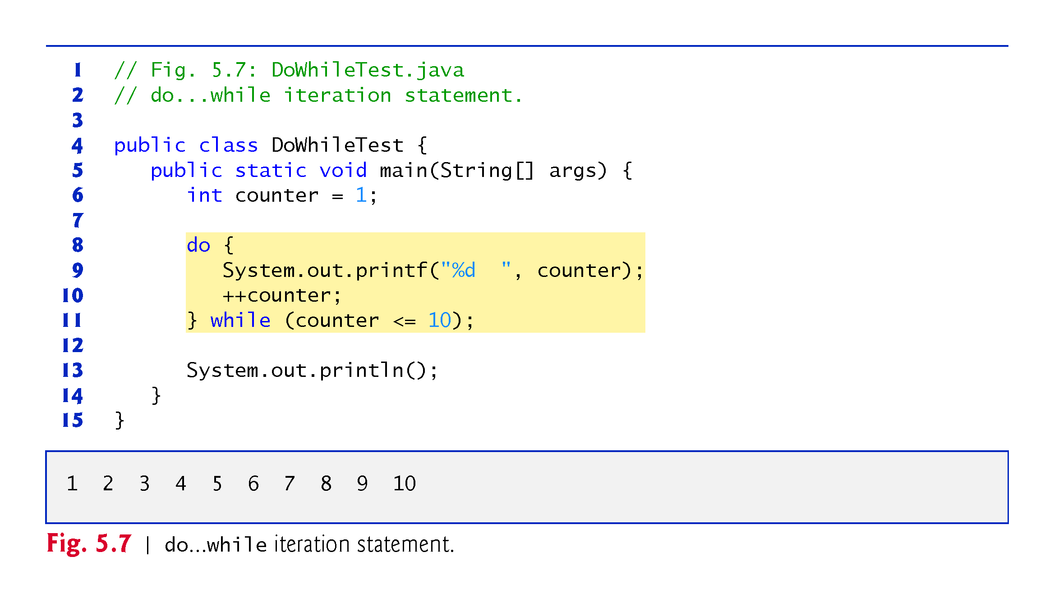

Slide 16
5.6 switch Multiple-Selection Statement
switch multiple-selection statement performs different actions based on the possible values of a constant integral expression of type byte, short, int or char.

Slide 17
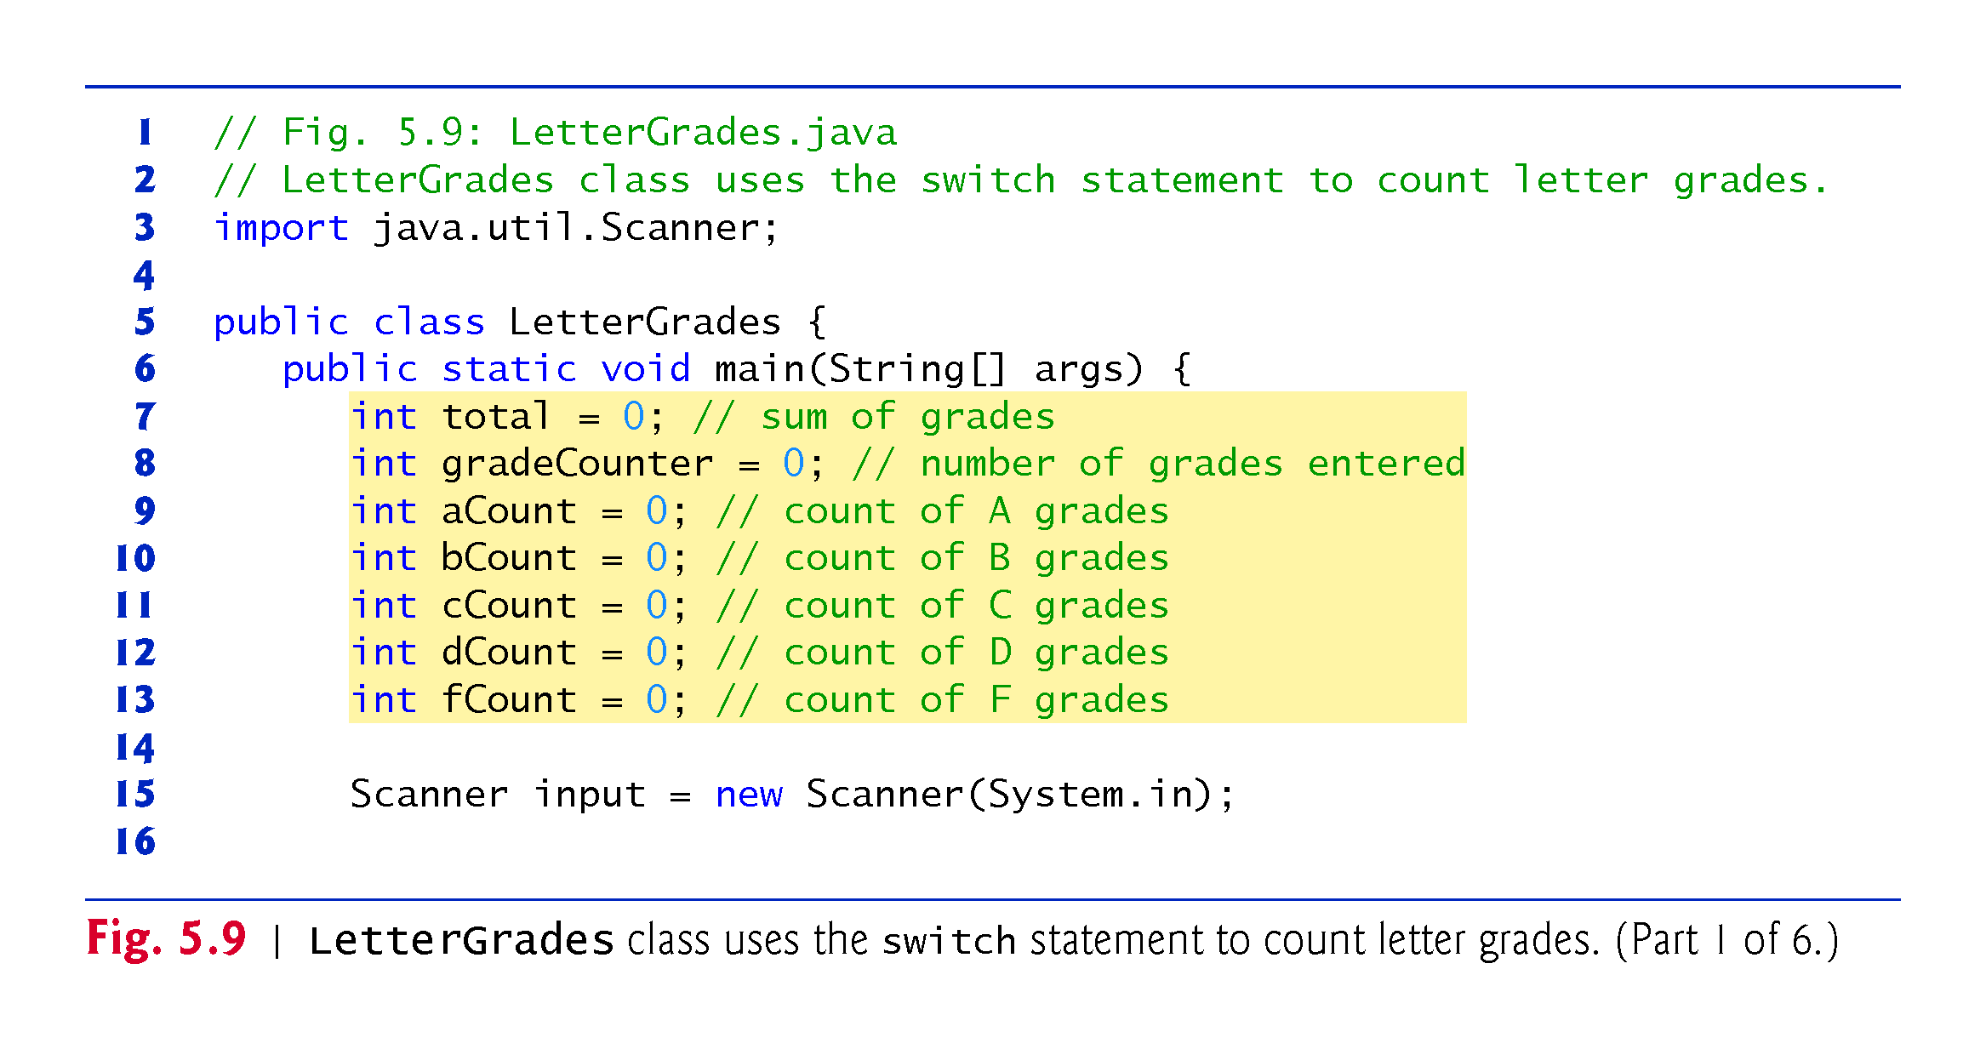

Slide 18
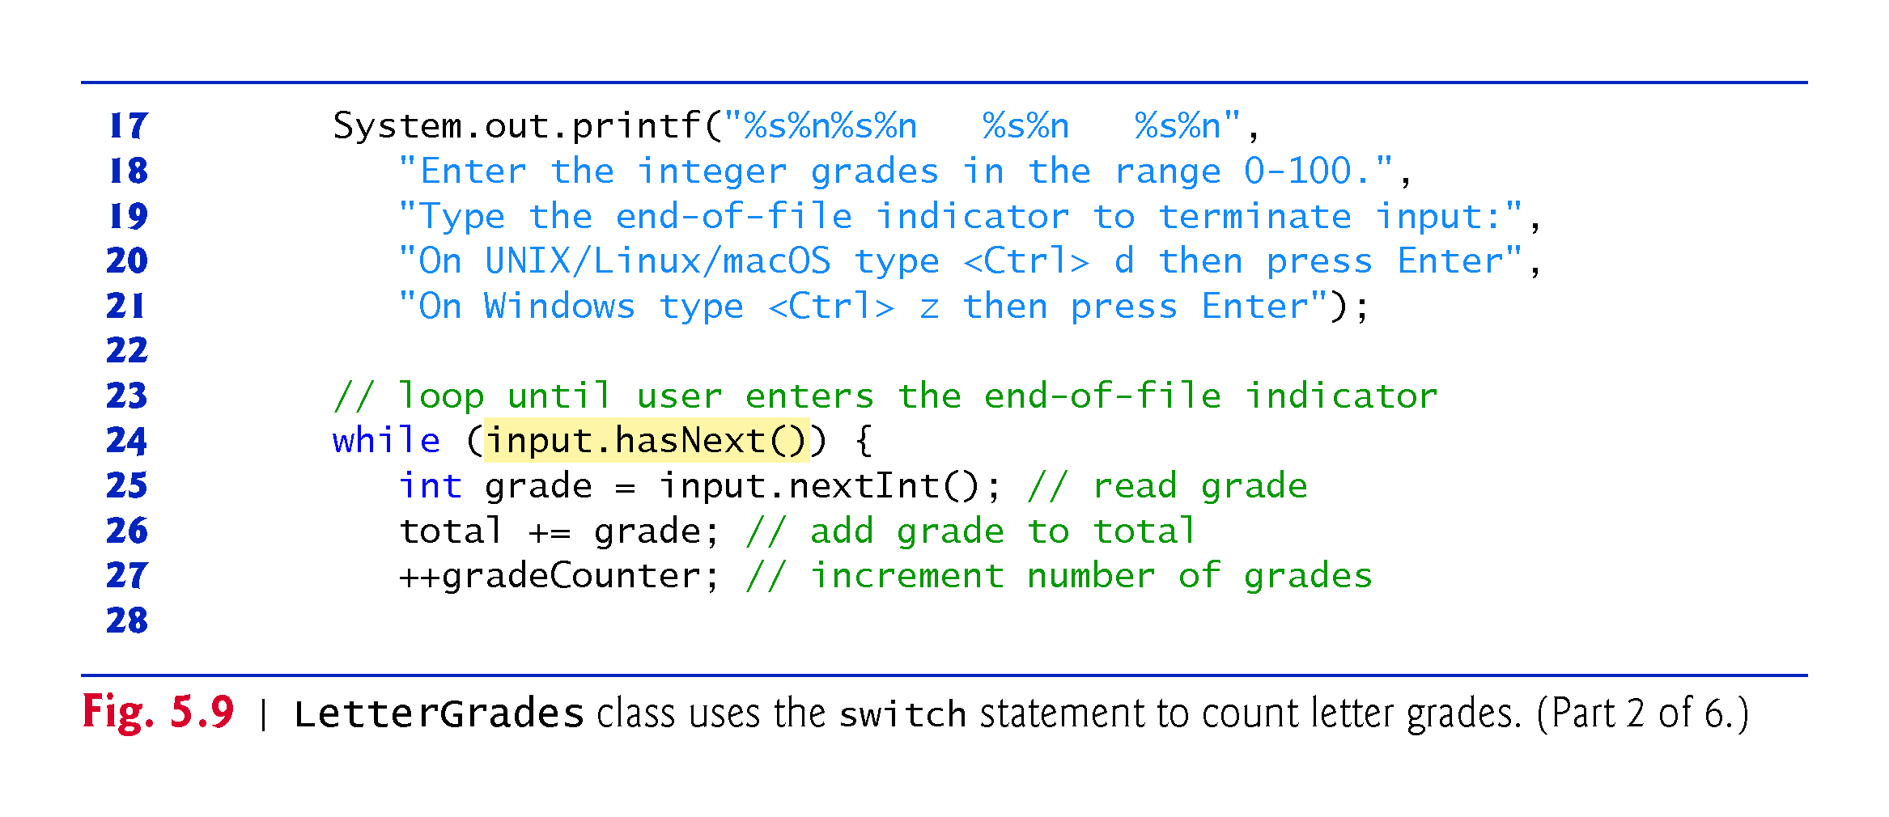

Slide 19
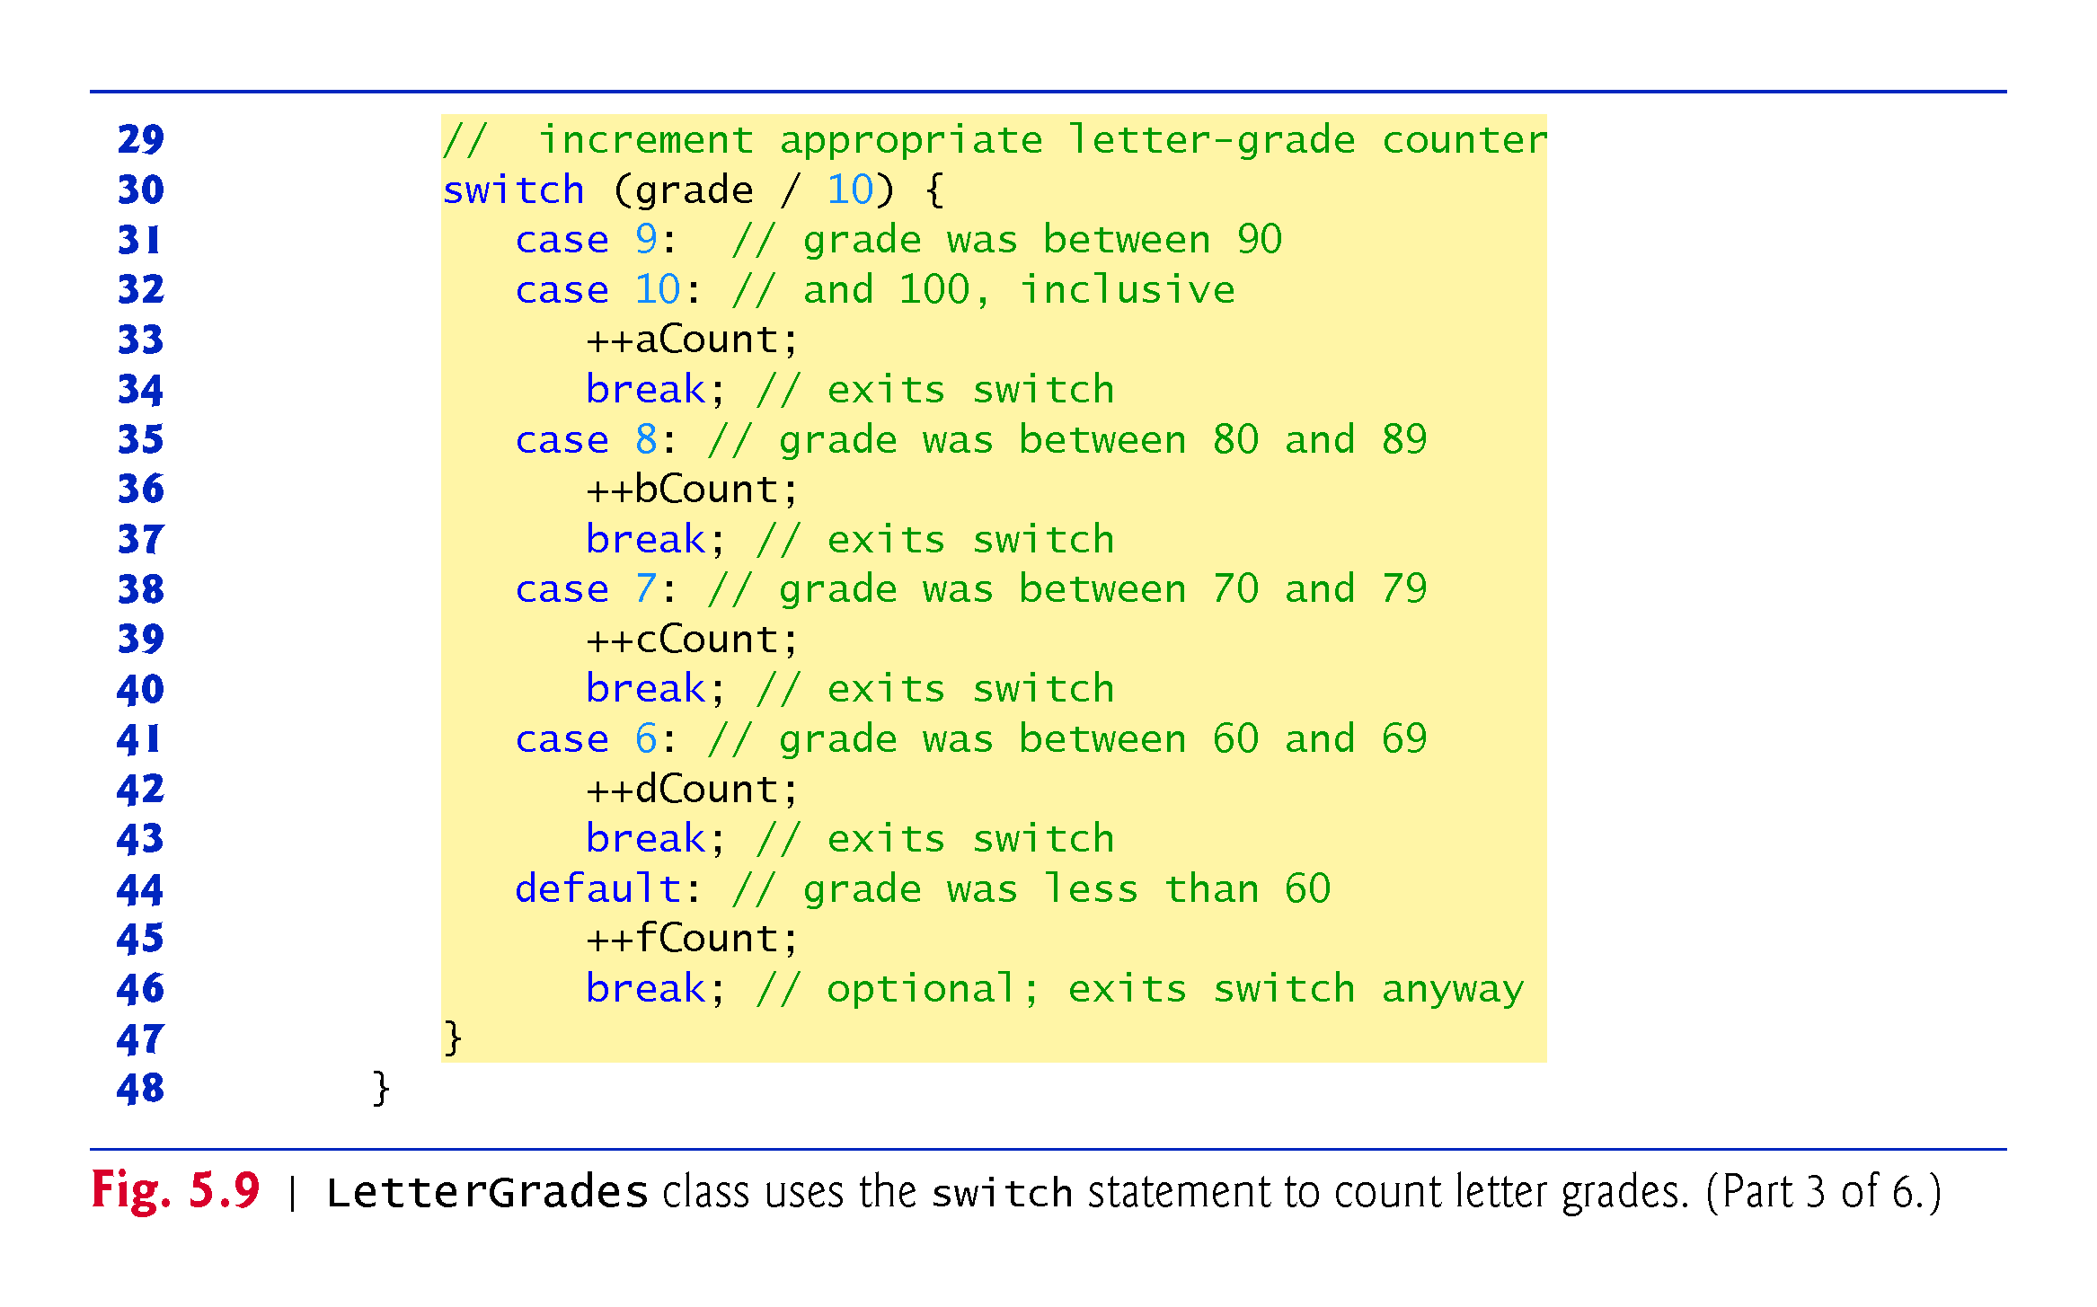

Slide 20
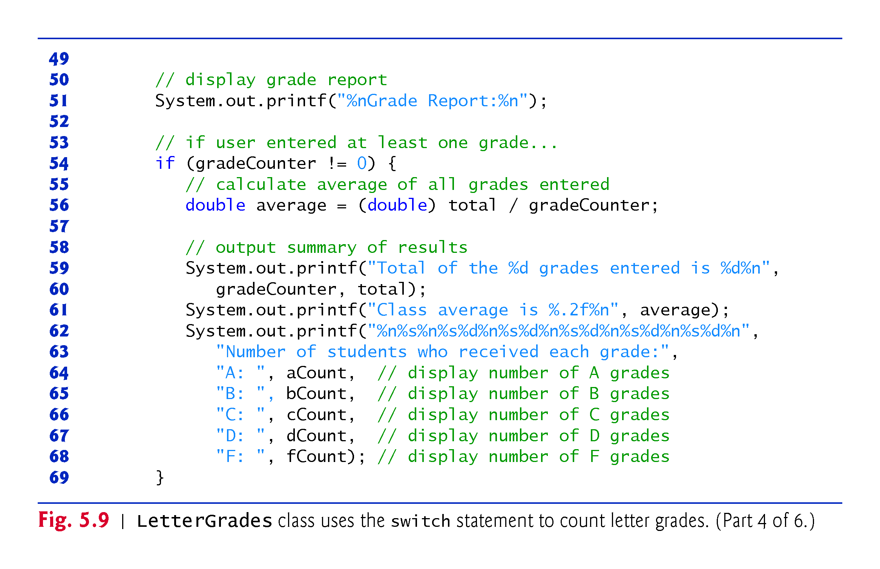

Slide 21
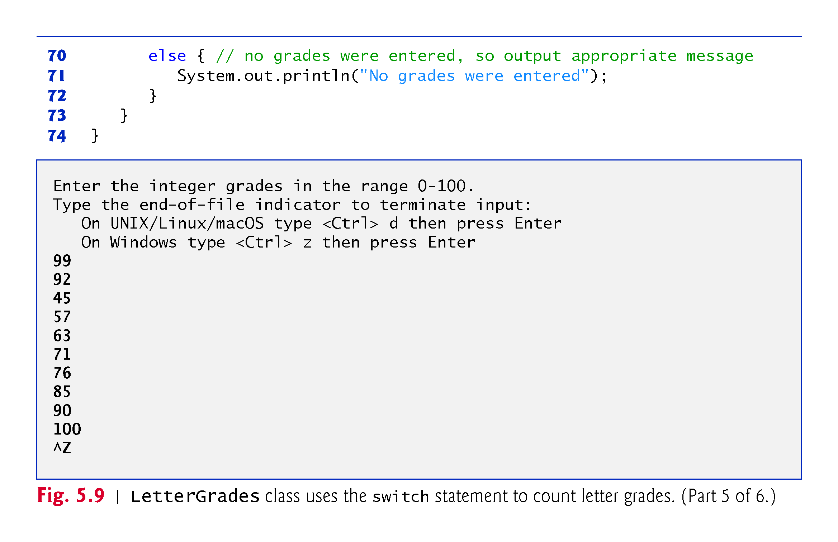

Slide 22
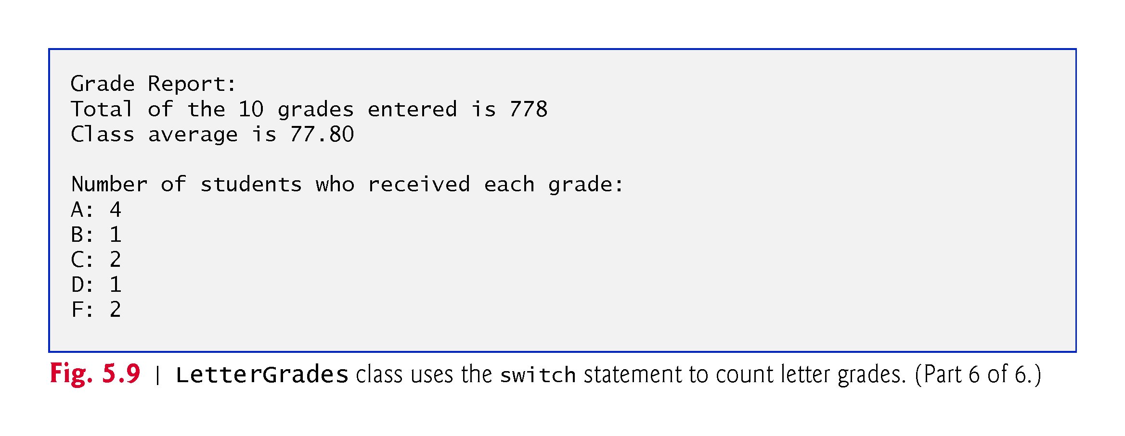

Slide 23
5.6 switch Multiple-Selection Statement (Cont.)
The switch statement consists of a block that contains a sequence of case labels and an optional default case.
The program evaluates the controlling expression in the parentheses following keyword switch.
The program compares the controlling expression’s value (which must evaluate to an integral value of type byte, char, short or int, or to a String) with each case label.
If a match occurs, the program executes that case’s statements.
The break statement causes program control to proceed with the first statement after the switch.

Slide 24
5.8 break and continue Statements
The break statement, when executed in a while, for, do…while or switch, causes immediate exit from that statement.
Execution continues with the first statement after the control statement.
Common uses of the break statement are to escape early from a loop or to skip the remainder of a switch.

Slide 25
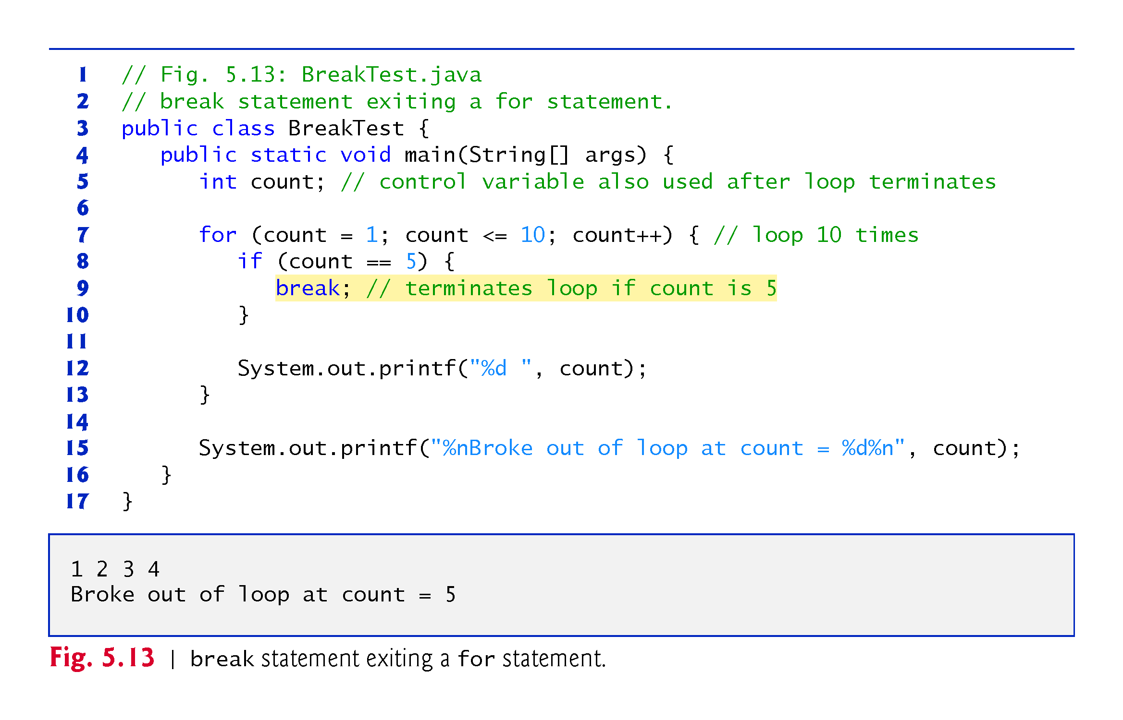

Slide 26
5.8 break and continue Statements (Cont.)
The continue statement, when executed in a while, for or do…while, skips the remaining statements in the loop body and proceeds with the next iteration of the loop.
In while and do…while statements, the program evaluates the loop-continuation test immediately after the continue statement executes.
In a for statement, the increment expression executes, then the program evaluates the loop-continuation test.

Slide 27
